Slide 1

AI JOURNAL WITH SENTIMENT ANALYSIS
SPRINT 1
26 March, 2026
Notes:
we still need to choose a logo and replace it with the one here

Slide 2
AGENDA OVERVIEW
01
06
TEAM MEMBER ROLES AND RESPONSIBILITIES
MVP
02
07
IMPROVEMENTS MADE FROM FEEDBACK
TECHNOLOGIES
03
08
PROJECT DESCRIPTION
ALGORITHMS
04
09
TEAM WORKING AGREEMENT
DIAGRAMS
05
10
USER PERSONAS
PRODUCT BACKLOG

Slide 3
AGENDA OVERVIEW CONTD.
11
16
SPRINT 1 BACKLOG
MVP
12
17
METRICS
OUR GITHUB
13
18
RETROSPECTIVE
LIVE APP DEMO
14
19
SPRINT 2 PLANNING
WIKI PAGE
15
20
PROJECT DEMO
TEAM NEXUS

Slide 4






TEAM MEMBERS
KRISHNA
CHINTAN KOTADIYA
RAFAELA HOLLANDA
Scrum Master | Developer
Developer | Tester
Team Leader | Developer
VANESSA AGBUGBA
SANKET MATROJA
SAI
Front End Developer
AI Generalist
Developer
Notes:
Are we including Professor Wong like he asked? I did it in case, if not, we can take it out.
Also we need Sanket's and Sai's roles
We also need pictures

Slide 5
IMPROVEMENTS MADE FROM PROFESSOR’S FEEDBACK
1. TEAM PRESENCE
2. RETROSPECTIVE FOCUS
FEEDBACK:
FEEDBACK:
ONE MEMBER WAS AWAY DURING THE PRESENTATION VIDEO
ONLY SPEAK ABOUT EFFECTIVENESS DURING RETROSPECTIVES
ALL MEMBERS WILL RECORD TOGETHER GOING FORWARD
KEEP RETROSPECTIVES STRICTLY ON PROCESS IMPROVEMENT
3. BOARD USAGE
4. AGENTIC AI
FEEDBACK:
FEEDBACK:
KUDOS FOR USING A BOARD IN OUR RETROSPECTIVE
TRY TO INTEGRATE AGENTIC AI / AI AGENTS INTO THE PROJECT
CONTINUE USING OUR BOARD FOR RETROSPECTIVES & PLANNING
IMPLEMENTING AGENTIC AI IDEAS IN SPRINT 2
Notes:
Used a random sad man's picture to depict mental health, lmk if it works! if not, we can change it.

Slide 6
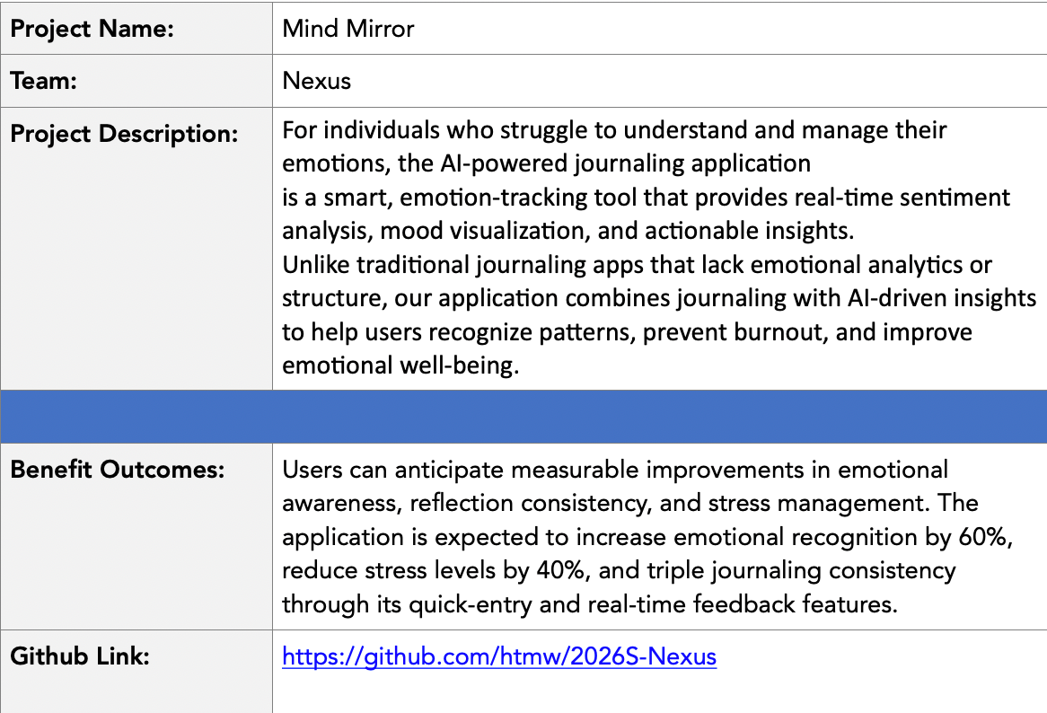
PROJECT DESCRIPTION

Slide 7

COMMUNICATION PLAN
• Primary instant meeting platform: WhatsApp
• Video Meeting: Discord
Team members are expected to:
• Communicate respectfully and professionally
• Respond to messages within a reasonable time frame (ideally within 24 hours)
• Share progress updates, blockers, and concerns openly
• Use the agreed communication tools for all project-related discussions
TEAM WORKING AGREEMENT
MEETINGS & AVAILABILITY
The team will hold three regular sync meetings per week:
• Sunday: 10:00 AM • Tuesday: 6:30 PM • Thursday: 9:00 PM
Additional meetings may be scheduled as needed based on sprint requirements. Expectations:
• All members should attend scheduled meetings
• If unable to attend, members must notify the team in advance
• Meeting notes and action items will be documented and shared
Team Nexus

Slide 8
TASK MANAGEMENT
WORK EXPECTATIONS &
DEFINITION OF DONE
• Task tracking tool: Jira
All project tasks will be:
• Clearly defined and assigned
• Tracked through Jira
• Updated regularly to reflect progress
• Completed before agreed internal deadlines
Each task is considered “Done” when:
• It meets the agreed acceptance criteria
• It is reviewed by at least one other team member (when applicable)
• Code runs without critical errors
• Relevant documentation is updated
• Changes are committed to the shared repository
Team members are responsible for:
• Completing assigned work on time
• Communicating blockers early
• Supporting teammates when needed
CONFLICT RESOLUTION
In the event of conflict:
1. The concerned party should first express the issue to the team openly and respectfully
2. The team will attempt to resolve the issue collaboratively
3. If unresolved, the issue will be escalated to the Team Leader / Scrum Coordinator
4. Further escalation (e.g., to the instructor) will be considered only if necessary

Slide 9

STUDENT PERSONA
NAME: SARAH MARTINEZ
Age: 21
Gender: Female
Occupation: Undergraduate Computer Science Student
Sarah is a full-time college student balancing coursework, part-time work, and social commitments. During exam periods, her stress levels rise significantly, but she often ignores the early warning signs of burnout. She occasionally journals but finds long entries overwhelming and inconsistent. She wants a simple way to reflect daily without spending too much time.
Challenges:
Experiences fluctuating stress levels during the semester
Inconsistent journaling habits
Difficulty recognizing emotional patterns over time
Feels overwhelmed during midterms and finals
Goals:
Track emotional trends throughout the semester
Identify early signs of burnout
Receive short, actionable suggestions
Maintain better emotional balance during academic pressure

Slide 10

WORKING PROFESSIONAL PERSONA
NAME: DAVID CHEN
Age: 32
Gender: Male
Occupation: Software Engineer
David works remotely for a tech company and spends most of his day attending meetings and coding. While he performs well professionally, he often feels mentally drained without clearly understanding the cause. He values productivity and self-improvement but rarely pauses to reflect on his emotional state.
Challenges:
Blurred boundaries between work and personal life
Emotional fatigue during high-pressure deadlines
No structured way to monitor mood patterns
Limited time for long reflection exercises
Goals:
Understand how work stress affects his mood
Monitor emotional stability over time
Receive quick, data-driven insights
Improve work-life balance

Slide 11

WORKING PARENT PERSONA
NAME: EMILY PETERSON
Age: 40
Gender: Female
Occupation: HR Manager
Emiliy balances a demanding job with parenting responsibilities. Her schedule leaves little time for self-reflection, yet she recognizes the importance of emotional awareness. She often feels emotionally exhausted but cannot clearly identify triggers or patterns. She prefers simple, easy-to-use digital tools.
Challenges:
Limited time for lengthy journaling
Emotional fatigue from multitasking responsibilities
Difficulty identifying emotional triggers
Wants non-clinical, supportive guidance
Goals:
Build daily emotional awareness
Identify patterns in stress levels
Receive manageable well-being suggestions
Maintain emotional stability for herself and her family

Slide 12

SELF-IMPROVEMENT ENTHUSIAST PERSONA
NAME: ALEX RIVERA
Age: 27
Gender: Male
Occupation: Fitness Coach
Alex actively tracks his workouts, sleep cycles, and productivity habits. He believes emotional well-being is just as important as physical health but lacks a structured system to measure it. He is interested in data-driven insights and enjoys tools that provide analytics and visualizations.
Challenges:
Journaling apps provide no analytical insights
No measurable way to track emotional consistency
Wants deeper pattern recognition
Prefers technology-backed recommendations
Goals:
Quantify emotional trends
Compare mood ratings with AI sentiment analysis
Identify emotional volatility
Optimize overall mental performance

Slide 13
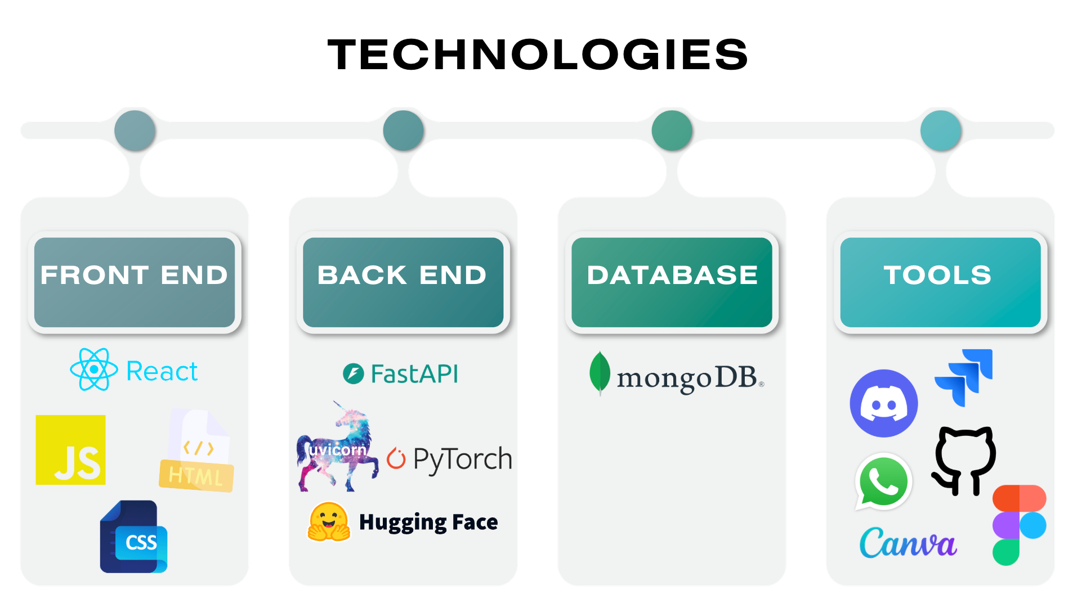

Slide 14
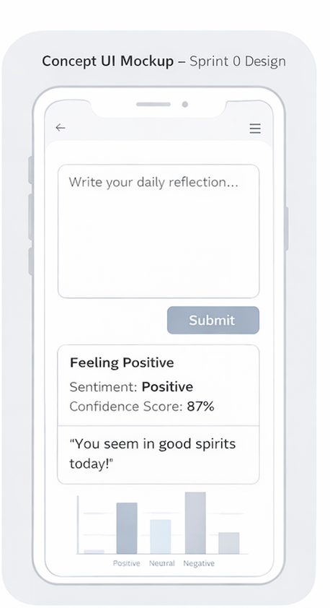
MINIMAL VIABLE PRODUCT (MVP)
An AI-powered journaling application with real-time emotional analysis and visual mood tracking.
Real-Time Sentiment Analysis – Journal entries are analyzed instantly using an NLP model.
Mood Classification System – Each entry is labeled as Positive, Neutral, or Negative.
Confidence Score Display – Shows the model’s certainty level for each classification.
Immediate Mood Feedback – Provides short, supportive emotional insights after analysis
Visual Mood Distribution – Displays a basic chart showing mood trends over time.
Local Entry Persistence – Saves journal entries locally for later review (MVP scope).

Slide 15

COMPONENTS
● Journal Input Manager : Handles user journal entry input and submission through the web interface.
● Backend API Manager : Manages HTTP requests and communication between frontend, sentiment model, and database.
● Sentiment Analysis Manager : Processes journal text and classifies sentiment (Positive / Neutral / Negative).
● Confidence Scoring Module: Extracts prediction probability scores from the DistilBERT output.
● Mood Feedback Generator: Converts sentiment results into short, supportive emotional insights.
● Data Persistence Layer : Stores journal entries, sentiment labels, confidence scores, and timestamps.
● Mood Visualization Manager: Retrieves stored data and generates mood distribution charts over time.

Slide 16
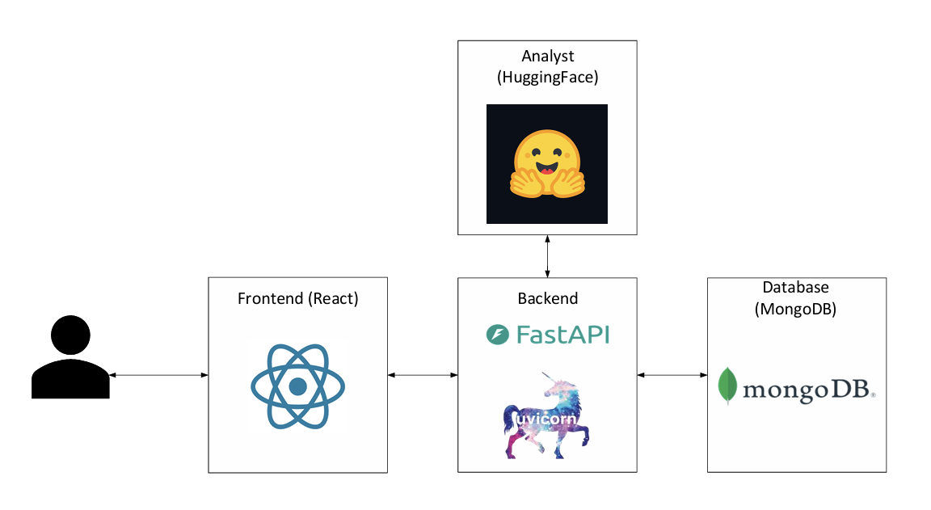
ARCHITECTURE DIAGRAM

Slide 17
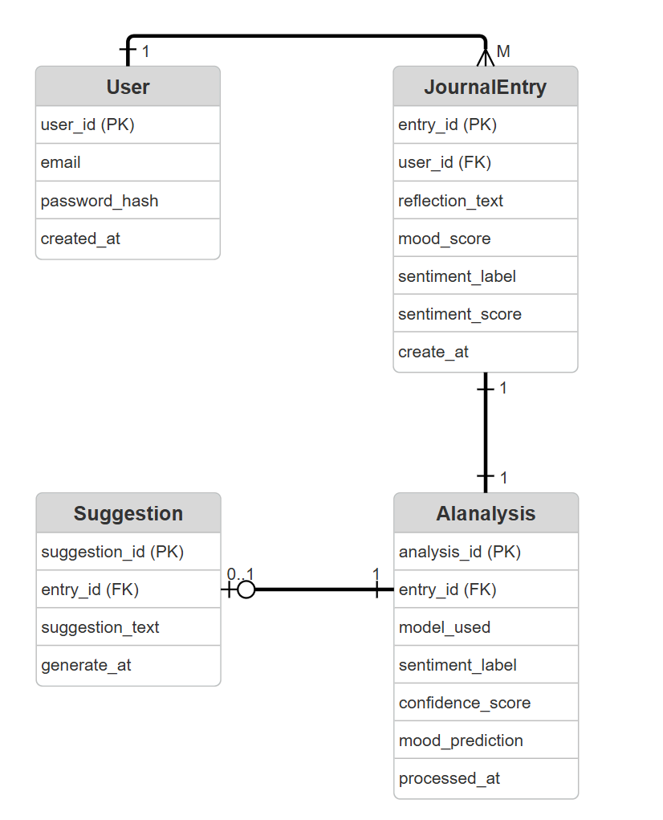
ER DIAGRAM

Slide 18
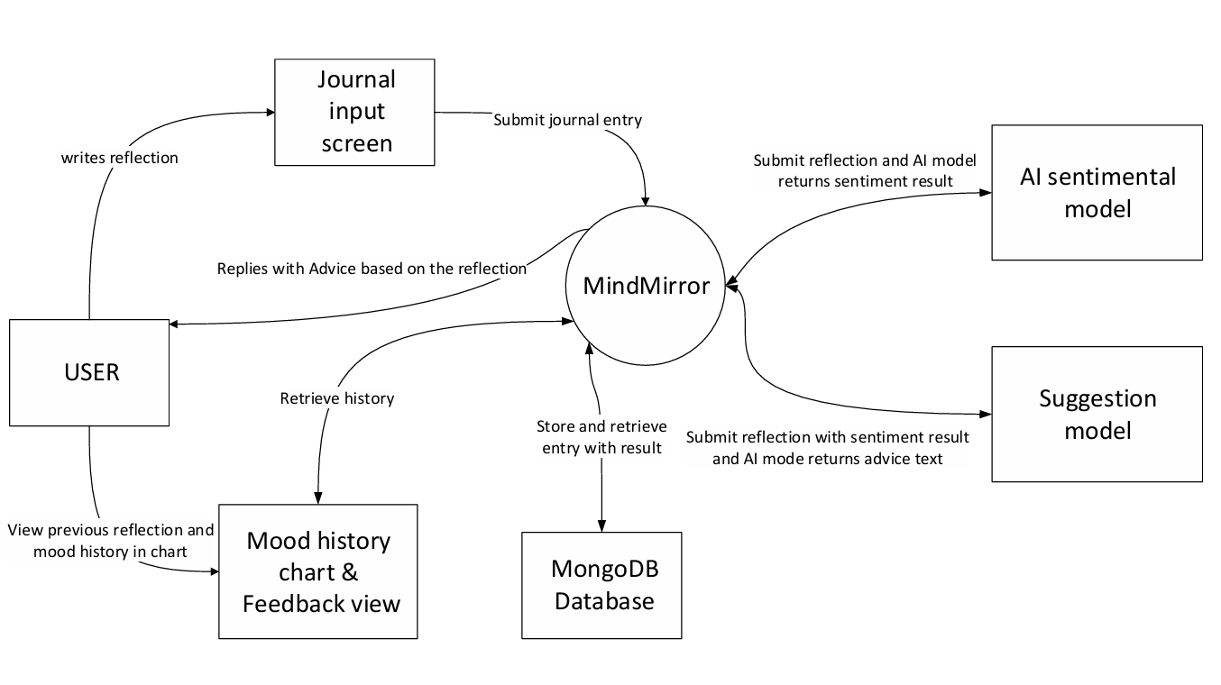
CONTEXT DIAGRAM

Slide 19
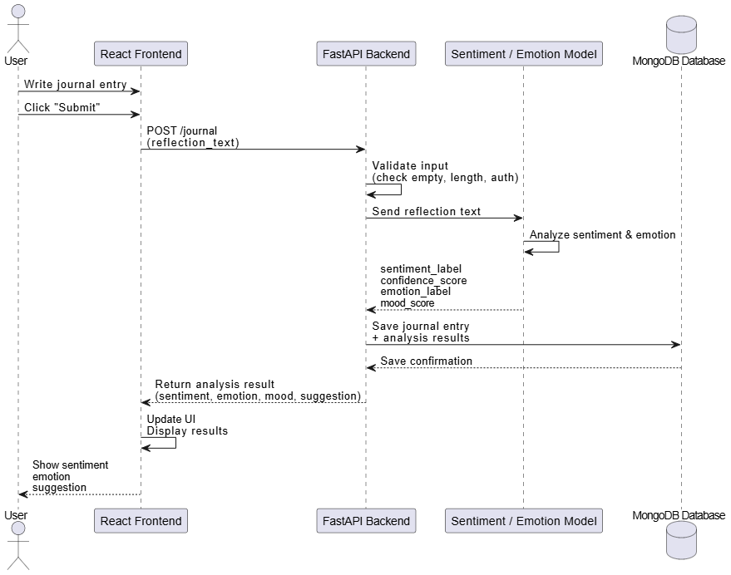
SEQUENCE DIAGRAM - JOURNAL ENTRY

Slide 20
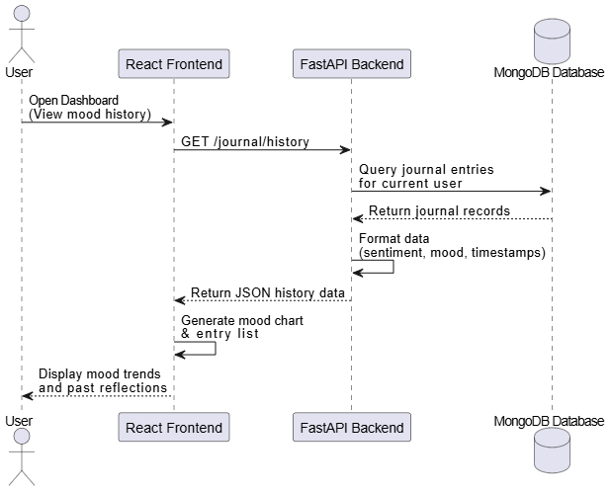
SEQUENCE DIAGRAM
DASHBOARD

Slide 21
PRODUCT BACKLOG
Core Journal
Functionality
Processing &
AI Analysis
Results &
User Feedback
US1 – Journal Entry Submission
As a user, I want to write and submit a journal entry so that I can reflect on my daily emotions.
Acceptance Criteria
Text input available
Submit button works
No empty submissions allowed
Priority: Must Story Points: 3
US7 – Input Validation
As a user, I want input validation so that my journal entries follow length and character rules.
Acceptance Criteria
Maximum length enforced
Allowed characters validated
Empty submissions prevented
Priority: Must Story Points: 2
US10 – Reset Input Field
As a user, I want the input field to reset after submission so that I can write a new entry easily.
Acceptance Criteria
Input cleared after successful submission
Priority: Must Story Points: 1
US2 – Journal Entry Processing
As a user, I want my journal entry to be processed after submission so that I can receive emotional analysis.
Acceptance Criteria
Entry sent to backend successfully
No submission errors
Priority: Must Story Points: 5
US3 – AI Sentiment Analysis
As a user, I want my journal entry analyzed by AI so that I understand whether my emotional tone is positive, neutral, or negative.
Acceptance Criteria
Backend sends text to the model
Sentiment label returned
Priority: Must Story Points: 8
US4 – Confidence Score
As a user, I want to see how confident the system is in its prediction so that I can better interpret the result.
Acceptance Criteria
Confidence score extracted
Score returned with prediction
Priority: Should Story Points: 2
US5 – Sentiment Result Display
As a user, I want to see my sentiment result immediately after submission so that I receive instant feedback.
Acceptance Criteria
Sentiment label displayed
Confidence score displayed
No page reload
Priority: Could Story Points: 3
US6 – Mood Visualization
As a user, I want to see a simple visualization of my mood history so that I can begin identifying patterns.
Acceptance Criteria
Chart renders correctly
Visualization updates after submission
Priority: Should Story Points: 5
US8 – Submission Confirmation
As a user, I want a confirmation message when my entry is submitted so that I know it was received.
Acceptance Criteria
Confirmation message displayed in UI
Priority: Must Story Points: 2

Slide 22
PRODUCT BACKLOG
Additional Features
Future Features
US5 – Sentiment Result Display
As a user, I want to see my sentiment result immediately after submission so that I receive instant feedback.
Acceptance Criteria
Sentiment label displayed
Confidence score displayed
No page reload
Priority: Could Story Points: 3
US6 – Mood Visualization
As a user, I want to see a simple visualization of my mood history so that I can begin identifying patterns.
Acceptance Criteria
Chart renders correctly
Visualization updates after submission
Priority: Should Story Points: 5
US8 – Submission Confirmation
As a user, I want a confirmation message when my entry is submitted so that I know it was received.
Acceptance Criteria
Confirmation message displayed in UI
Priority: Must Story Points: 2
US11 – User Registration
As a user, I want to register an account so that my journal entries are securely stored
Acceptance Criteria
Email & password required
Password hashed
User saved in database
Duplicate email prevented
Priority: Will not have Story Points: 5
US12 – User Login
As a user, I want to log in so that I can access my journal dashboard.
Acceptance Criteria
JWT token generated
Protected routes enforced
Login error handling
Priority: Will not have Story Points: 5
Detailed spreadsheet here

Slide 23
SPRINT 1 BACKLOG
Sprint Name: Sprint 1
Sprint Duration: February 20 – March 2026
Sprint Length: 3 Weeks
Sprint Goal
Deliver a functional journaling workflow that allows users to submit journal entries and begin sentiment analysis processing.
Stories Committed
US1, US2, US3, US4, US5, US6, US7, US8, US9, US10, US13
Total Story Points Committed: 51
Detailed spreadsheet here

Slide 24
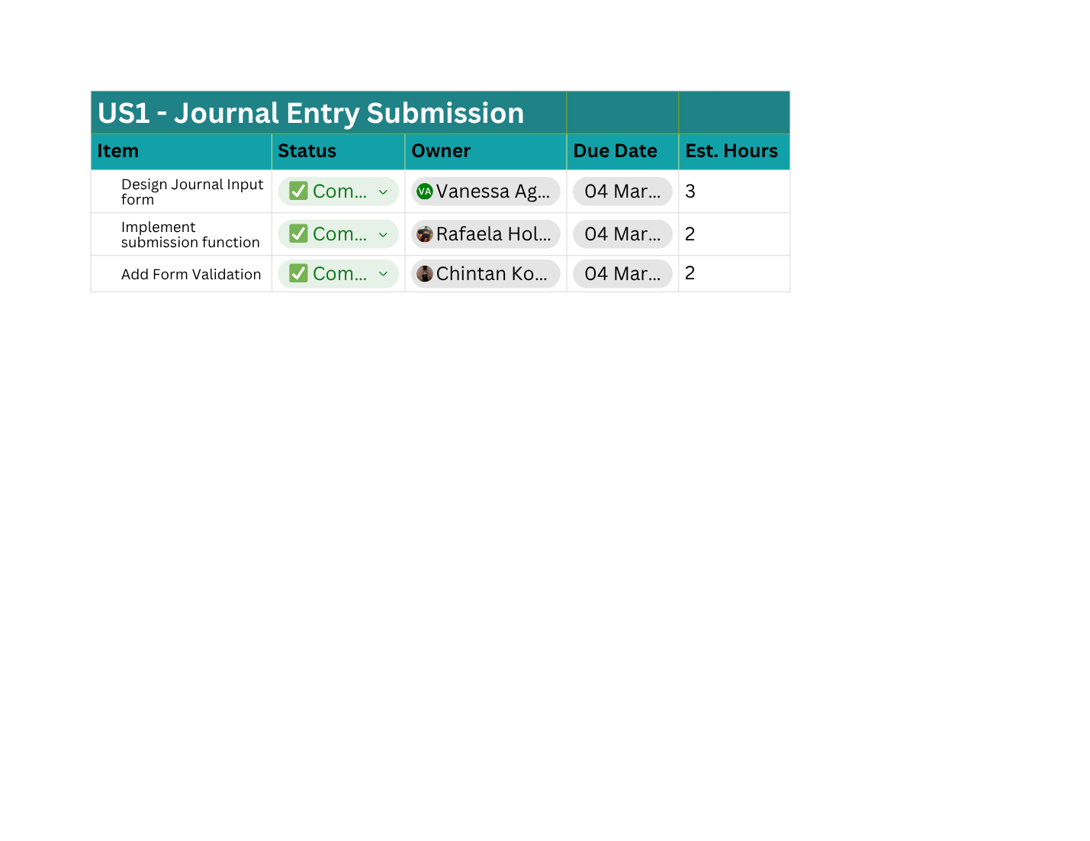
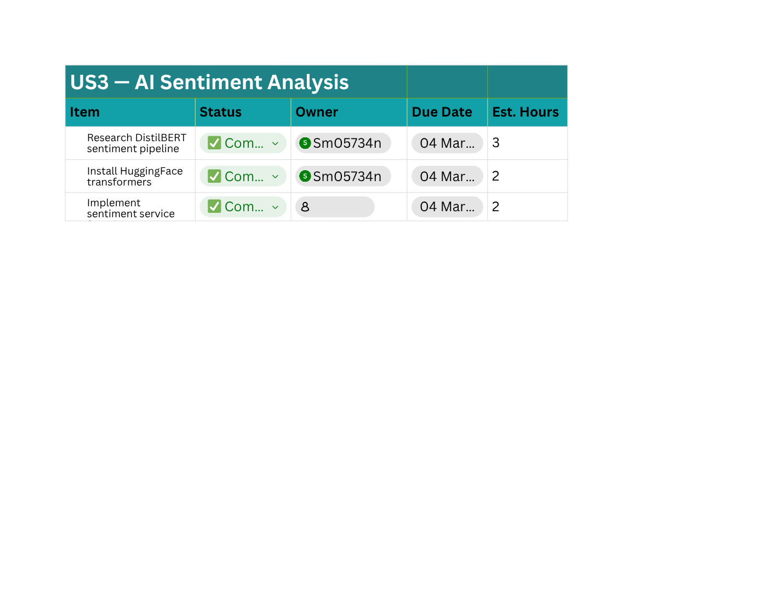
SPRINT 1 TASK BREAKDOWN
During Sprint 1, user stories were decomposed into technical tasks to distribute work among team members and track implementation progress.
Task breakdown allows the team to:
Assign clear responsibilities
Estimate development effort
Track sprint progress
Enable parallel development
Detailed spreadsheet here

Slide 25
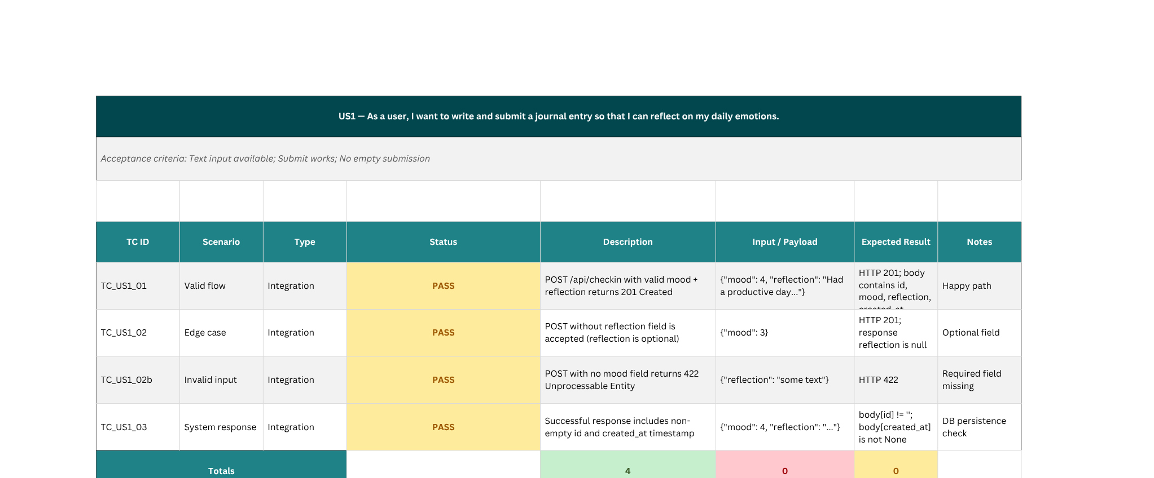
SPRINT 1 TEST CASE
Detailed spreadsheet here

Slide 26
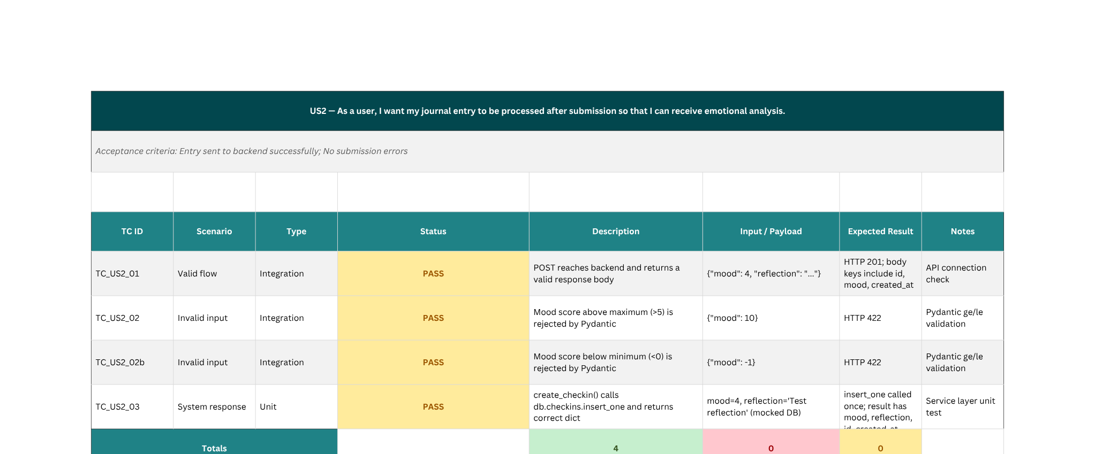
SPRINT 1 TEST CASE
Detailed spreadsheet here

Slide 27
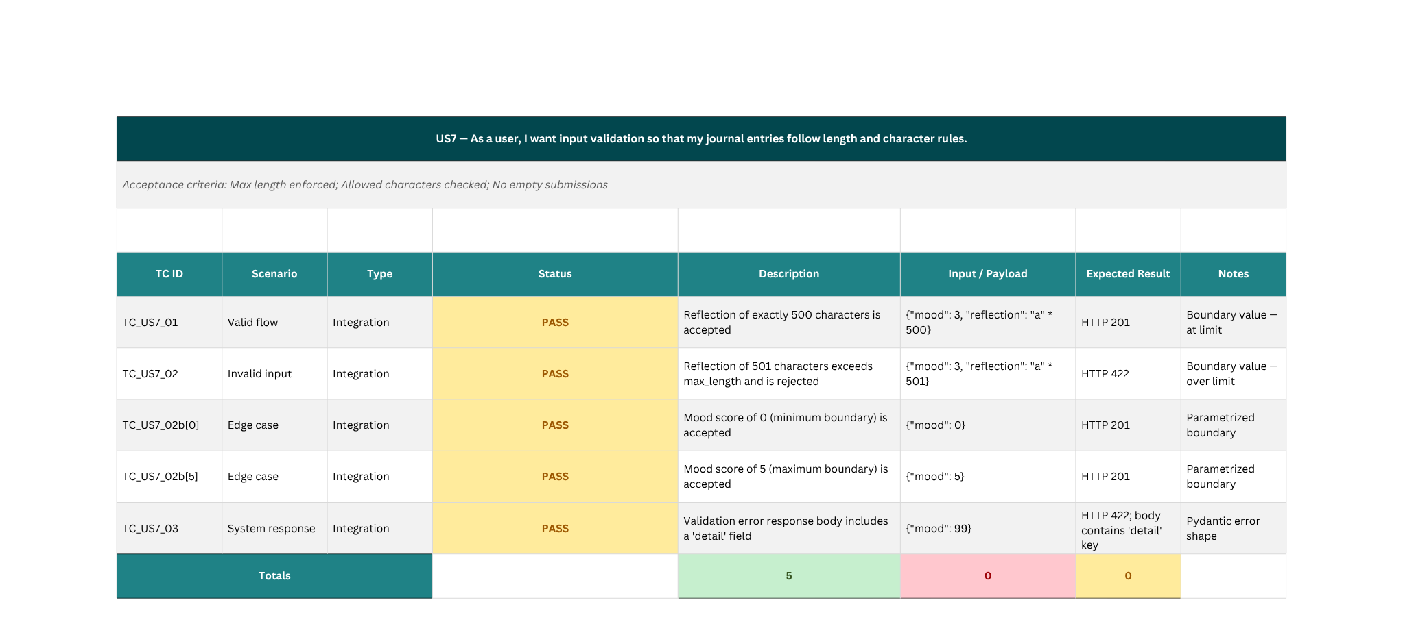
SPRINT 1 TEST CASE
Detailed spreadsheet here

Slide 28
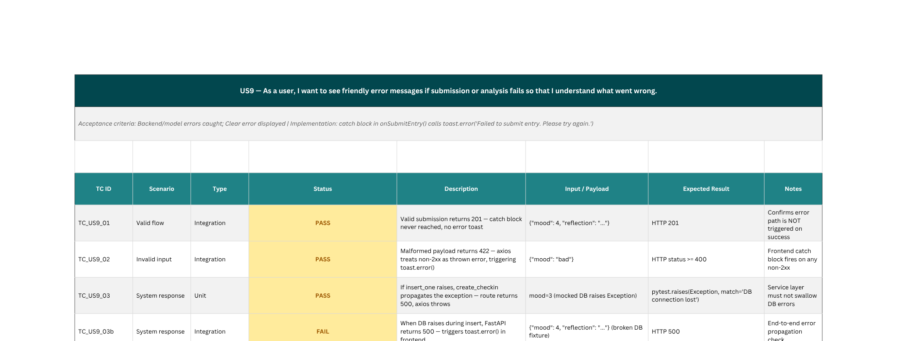
SPRINT 1 TEST CASE
Detailed spreadsheet here

Slide 29
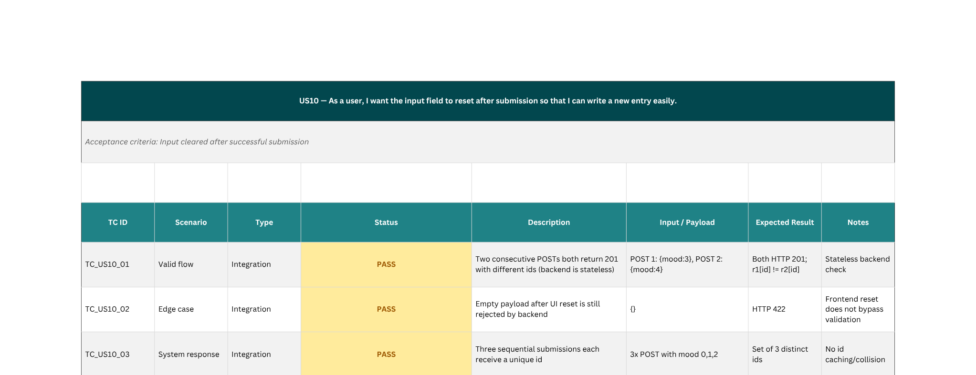
SPRINT 1 TEST CASE
Detailed spreadsheet here

Slide 30
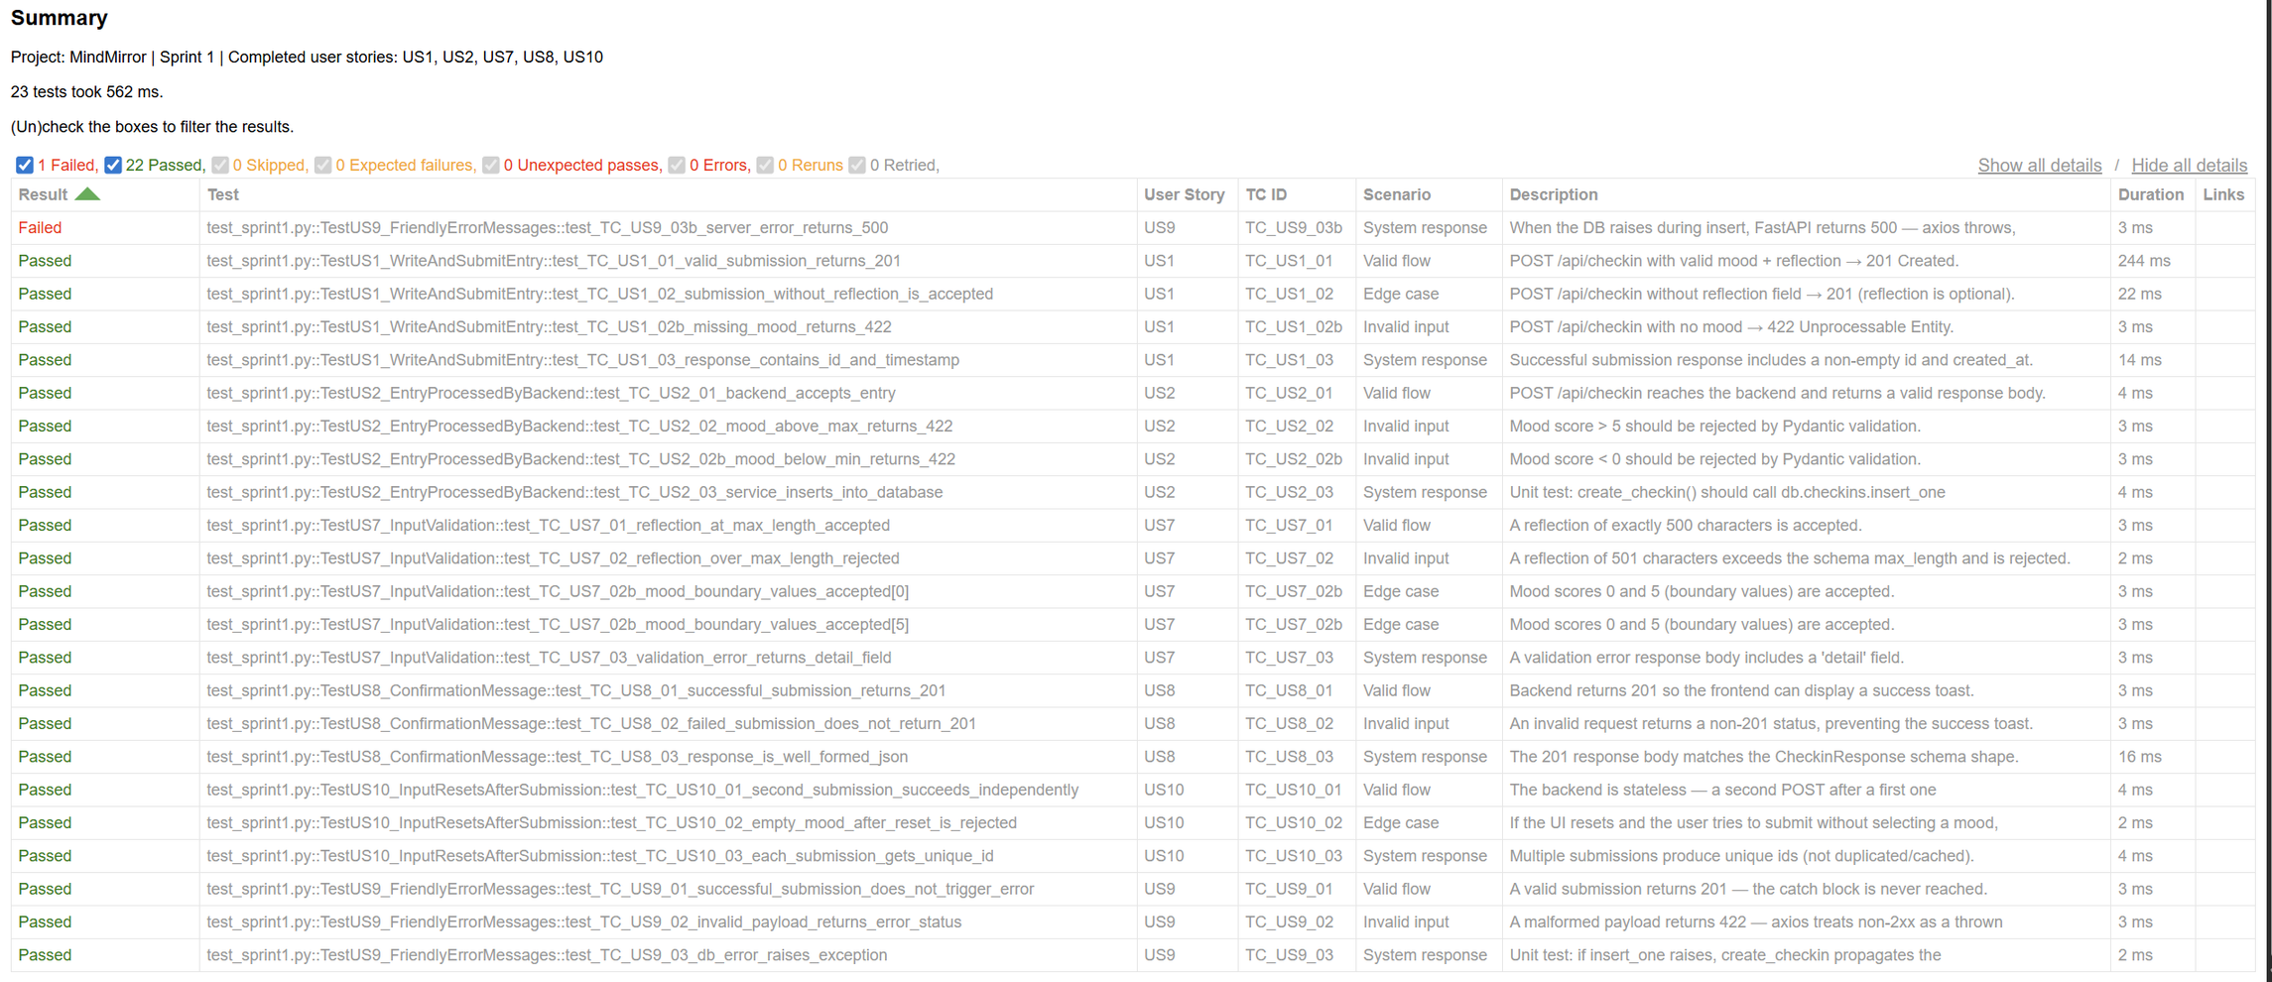
SPRINT 1 TEST CASE SUMMARY

Slide 31

SPRINT 1 STORIES COMPLETED
US1 - Journal entry submission
US2 - Journal entry processing
US3 - AI sentiment analysis
US4 - Confidence score display
US5 - Sentiment result display
US7 - Input validation
US8 - Submission confirmation
US9 - Error handling
US10 - Input field reset
US13 — View previous journal entries - half completed
Detailed spreadsheet here

Slide 32
SPRINT 1 STORIES NOT COMPLETED
These stories will be carried over to Sprint 2 for completion:
US6 - Mood visualization
US13 - User related
Deferred Stories (Out of Sprint Scope)
The following stories were intentionally excluded from Sprint 1, as they were classified as Will Not Have for the MVP:
US11 – User Registration
As a user, I want to register an account so that my journal entries are securely stored.
US12 – User Login
As a user, I want to log in so that I can access my journal dashboard.
These features are planned for future sprints after the core journaling and sentiment analysis functionality is fully implemented.
Detailed spreadsheet here

Slide 33
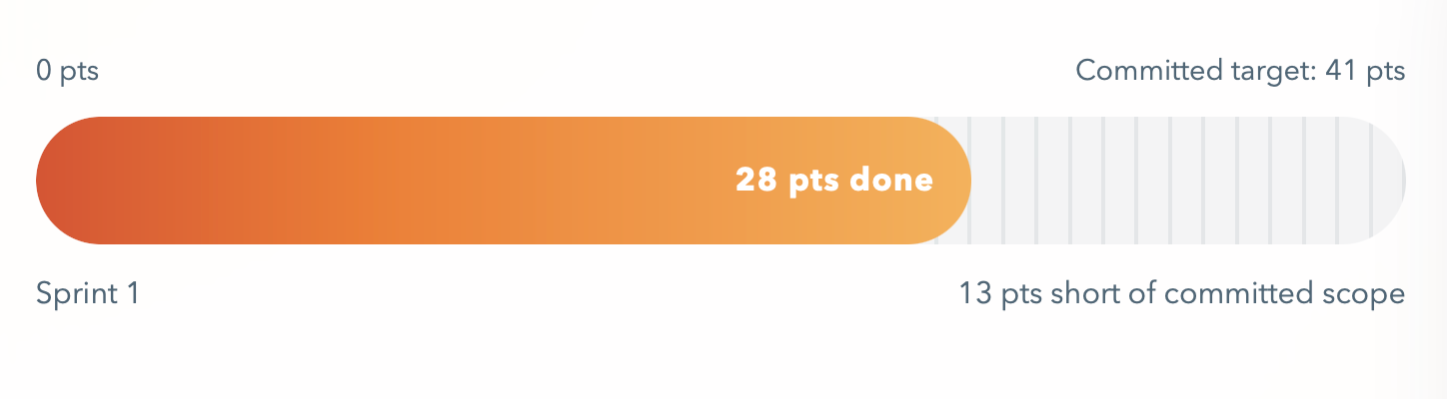
METRICS
TEAM VELOCITY
WHAT IS TEAM VELOCITY? THE TOTAL NUMBER OF STORY POINTS COMPLETED IN THIS SPRINT — NOT ISSUE COUNTS. TEAM NEXUS COMPLETED 28 STORY POINTS IN TN SPRINT 1. THE COMMITTED SCOPE WAS 41 POINTS; 13 POINTS REMAINED OUTSIDE THE COMPLETED TOTAL (SUBMISSION FLOW, MODEL INTEGRATION, VALIDATION, SENTIMENT DISPLAY WERE DELIVERED; CHART AND HISTORY WORK STILL IN PROGRESS).

Slide 34
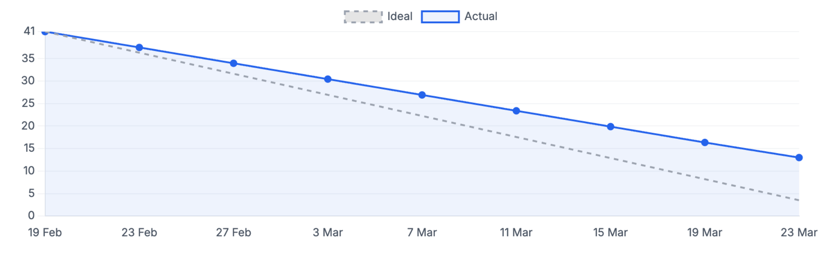
BURNDOWN STATUS
IT TRACKS REMAINING WORK OVER THE SPRINT TIMELINE. THE DASHED LINE SHOWS THE IDEAL PACE (STEADY BURN TO O). THE SOLID LINE SHOWS ACTUAL PROGRESS. TN SPRINT 1 STARTED WITH 41 COMMITTED POINTS AND ENDED WITH 13 POINTS REMAINING (28 BURNED DOWN). SPRINT DATES: 20 FEB - 27 MAR.

Slide 35
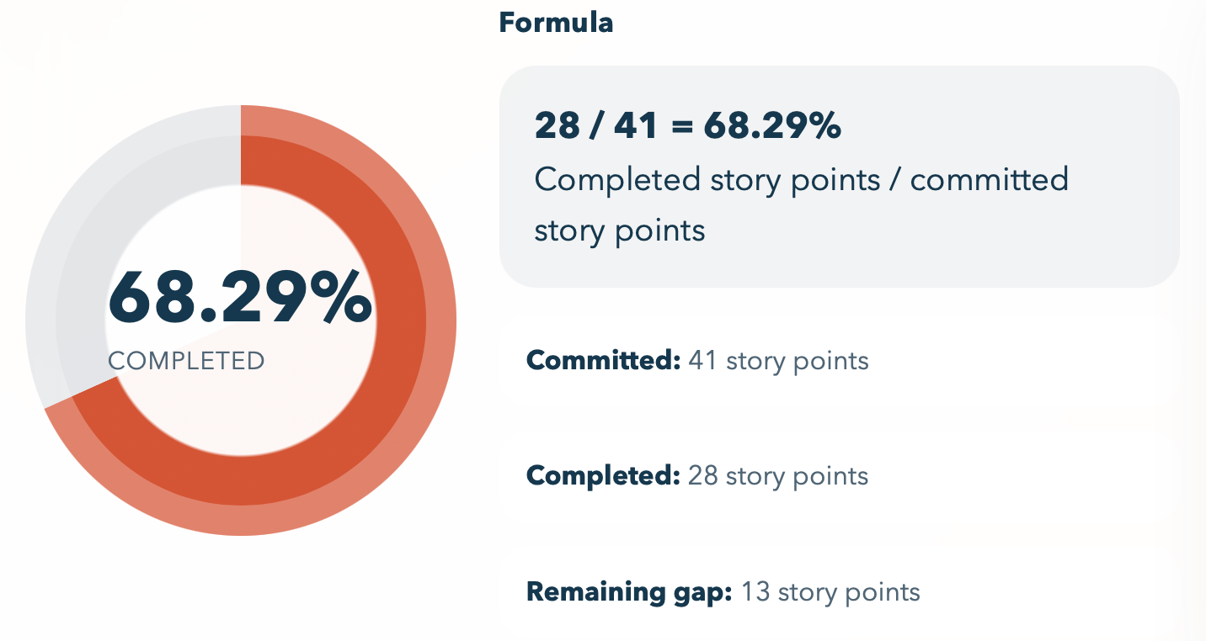
COMPLETED VS COMMITTED

Slide 36
RETROSPECTIVE
WHAT WENT WELL
WHAT COULD BE IMPROVED?
ACTIONS FOR NEXT SPRINT
Strong collaboration across different tasks (frontend, backend, and AI) enabled parallel progress
Co-ownership model worked effectively, especially for shared responsibilities across team members
Task breakdown helped clarify responsibilities and made it easier to track progress during the sprint
Communication could be more consistent across the team
Need for more proactive follow-ups (e.g., setting up quick sync calls to ensure tasks stay on track)
Daily stand-ups could be more structured and focused on blockers and progress
Establish more consistent communication by scheduling quick check-ins when blockers arise
Encourage team members to proactively reach out and coordinate instead of waiting for meetings
Improve stand-up effectiveness by focusing on: what was done, what’s next, and any blockers

Slide 37
WIKI PAGE LINK

Slide 38
DEMO

Slide 39
THANK YOU
26 Mar, 2026

